Slide 1
NFL Rushing
By Matt Tilley

Slide 2
Introduction
Each year, the NFL spends millions of dollars evaluating players and formations to try and gain a competitive advantage
In this project, we will try to solve the debate between the 3-4 defense and the 4-3 defense
We will also look at what offensive formations are best on 3rd and short and 4th and short
Finally, we will look at what running formations are most successful and if teams that run the ball more have better running plays on average

Slide 3
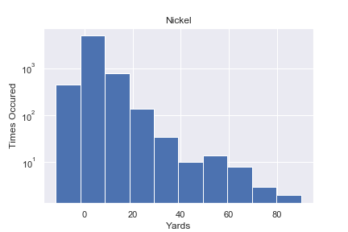
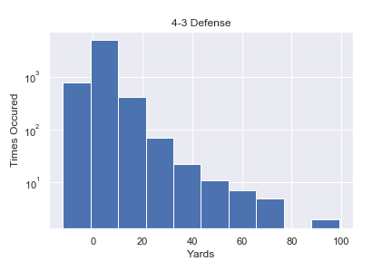
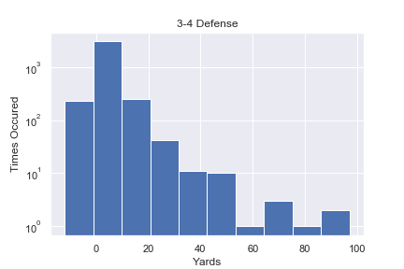
Nickel vs 4-3 vs 3-4 (Full Data)
Notes:
Every off season, teams switch from the 4-3 to the 3-4 and vice versa. This change often requires an entire overhaul to the defensive roster. Is one better than the other? Against the run, both look pretty similar. Instead of trying to find players for whichever defense is most popular at the time, teams should try and play the scheme that is less popular (and cheaper)

Slide 4
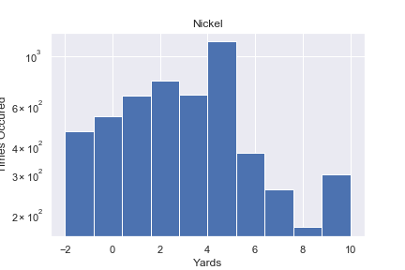
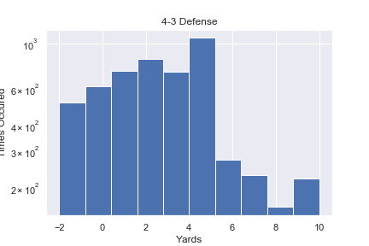
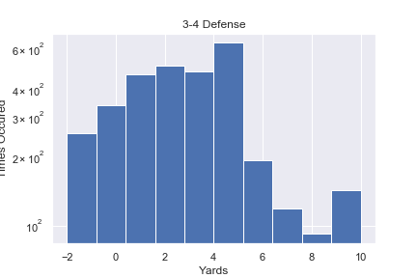
Nickel vs. 4-3 vs 3-4 (All runs >= -2 and <=10)
Notes:
With the big plays removed, both defenses are still very similar. The nickel on the other hand, gives up more yards per play than the two base defenses even though it is a better pass defense.

Slide 5
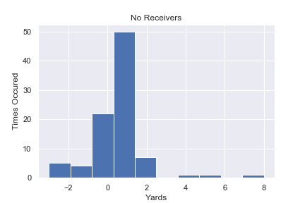
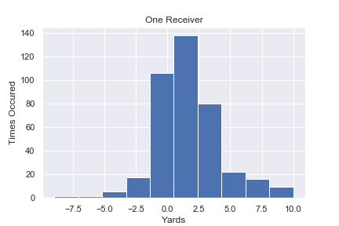
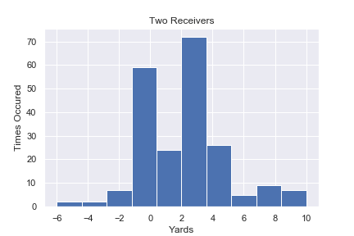
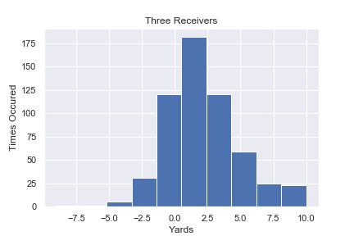
3rd and 4th Down with 3 or Fewer Yards to Go
Notes:
Some of the most important plays in a game are when it is third and short or fourth and short. But what is the best formation to line up in as an offense? To better answer that question, we will only look and 3rd and 4th down with 3 yards or less to go. We will then look at a breakdown of yards based on the number of wide receivers on the field. It looks like having more receivers on the field increases the chances of getting more yards on a play. Teams use 3 receivers the most but use only one receiver the second most.

Slide 6
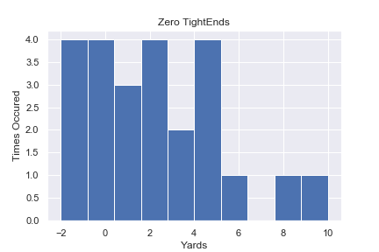
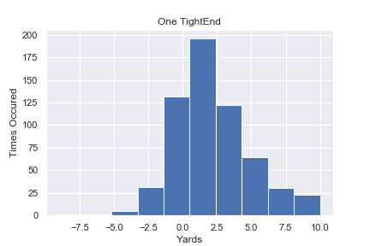

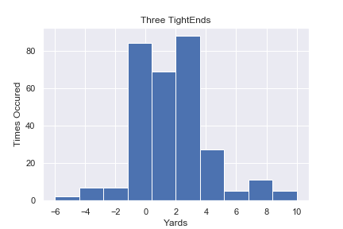
Number of Tight Ends on Third and Fourth and Short
Notes:
On the other hand, it looks like there are diminishing returns when it comes to tight ends. It is still beneficial to have a tight end in this situation but after one, the yardage declines.

Slide 7
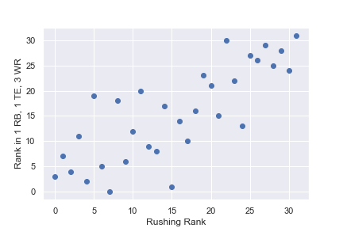
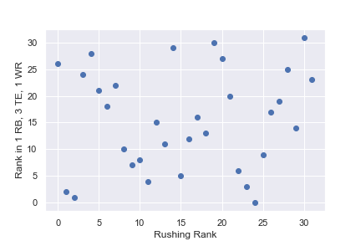
Regular Rushing: Tight Ends vs Wide receivers
Notes:
Here we can see the relationship between successful running and having 3 wide receivers on the field. If we remove the top two rushing offenses it looks like there is a slightly negative correlation between success with 3 tight ends and overall rushing rank. This data comes from the entire data set and not just the short yardage set.

Slide 8
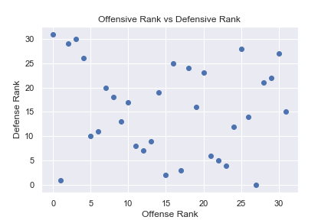
Does a good rushing offense mean a good rushing defense?
Correlation | -0.123
P-value | 0.5021
Notes:
Do teams that run the ball well defend the run well? Sometimes. Some teams do one well and the other poorly, some teams do both well and some teams are bad at both but there doesn’t seem to be any clear pattern.

Slide 9
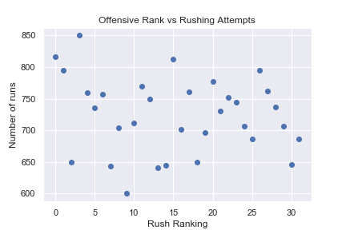
Does running more mean better running?
Correlation | -0.167
P-Value | 0.361
Notes:
When it comes to running the football, does quantity lead to quality? The top 2 teams had the most rushing attempts but the 3rd best team ran the ball the 5th fewest times. There does seem to be a slight correlation though so we will need to get more data before we can be certain. Overall though, it seems like if you run the ball well, you should run a lot. If you don’t run the ball well, running more isn’t going to help you

Slide 10
Data Sources and Limitations
The data comes from the NFL Rushbowl competition and can be found on Kaggle.com
The data consists only of run plays and the NFL is becoming more focused on the pass every year
In order to get a better understanding of the entire play, it would be helpful to add in data from passing downs

Slide 11
Conclusions
More successful runs out of passing formations.
The Nickel defense is not as good at stopping the run as the 4-3 and the 3-4 defense, so the more an opposing defense is in nickel, the more successful the run game will be
Tight Ends seem like the best of both worlds (blocking and catching) and having one on the field is helpful but adding more than 1 Tight End results in less effective rushing
The 4-3 and 3-4 are the same against the run so unless one formation is significantly better against the pass, it makes sense to build your defense around whichever scheme is less popular at the time.

